Slide 1
Using Python for Data Analysis in Gas Adsorption and Thermal Degradation of ZIF-8 Films
Eliseo Perez Gomez
Mathematical Analysis and Modeling – CME 502
6th May, 2025

Slide 2
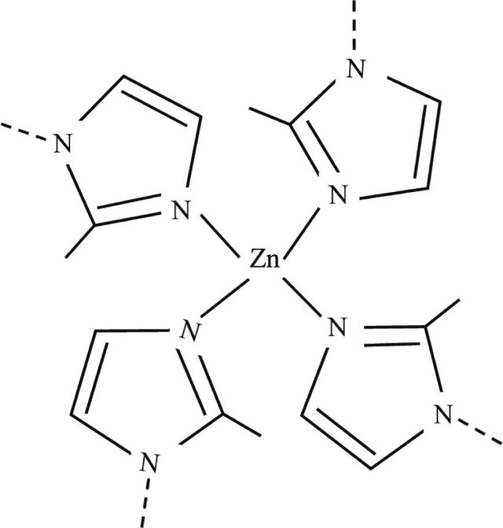
What are the ZIF-8?
ZIF-8 (Zeolitic Imidazolate Framework-8) is a type of metal-organic framework (MOF) — a porous material made from metal ions and organic molecules.
Why is ZIF-8 interesting?
It’s chemically stable, even in water and many solvents.
It has high surface area and selective adsorption.
Its nanoporous structure is similar to natural zeolites.
Pulser
Where is ZIF-8 used?
Gas storage and separation
Catalysis
Sensing
Drug delivery
Environmental cleanup

Slide 3
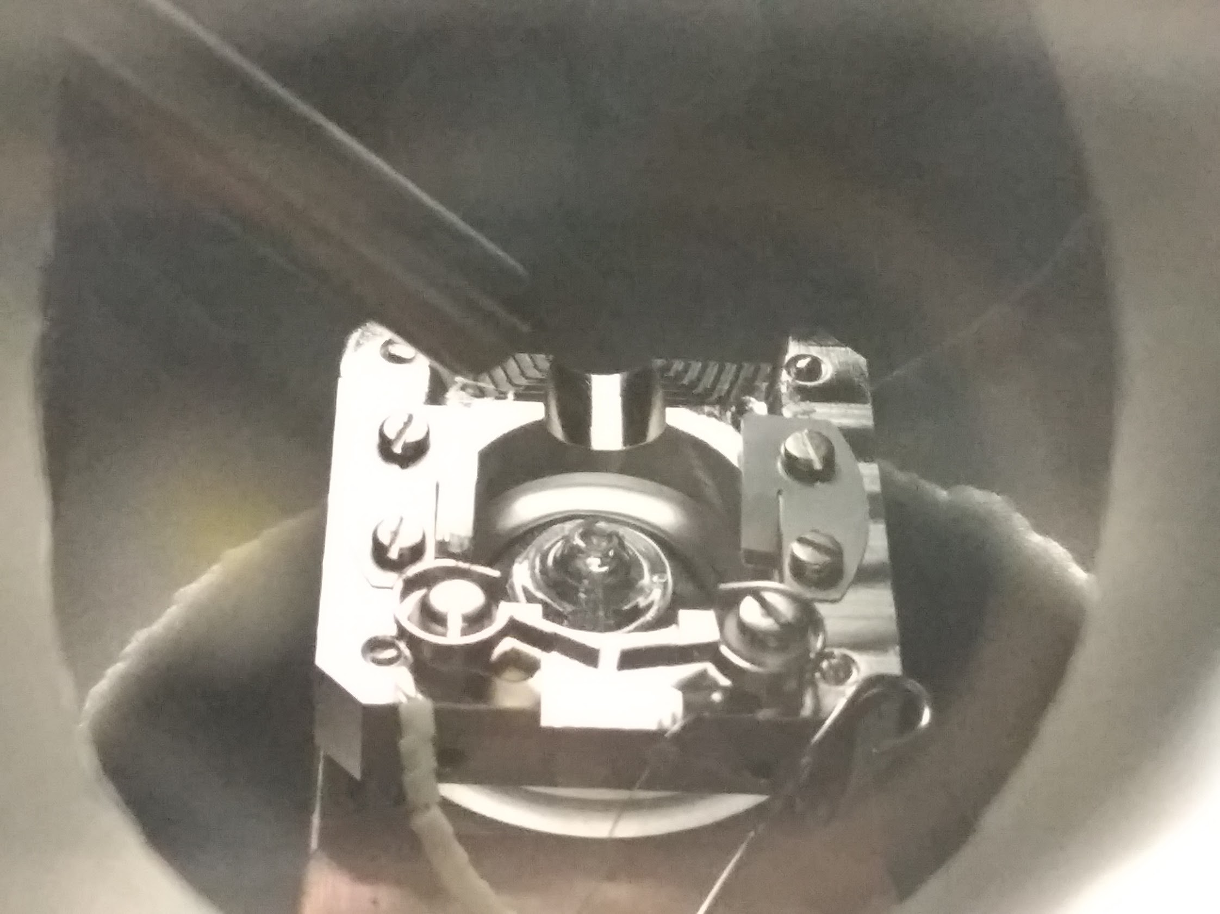

What is Transient Kinetics?
Focuses on reactions under non-steady conditions
The process starts with a sudden change
Pulse of reactant
Temperature shift
Pressure change
Pulser
In this work, we use a pulsing valve system to dose pulses of CO to our sample
A schematic sample and the pulser in the IRRAS chamber.

Slide 4
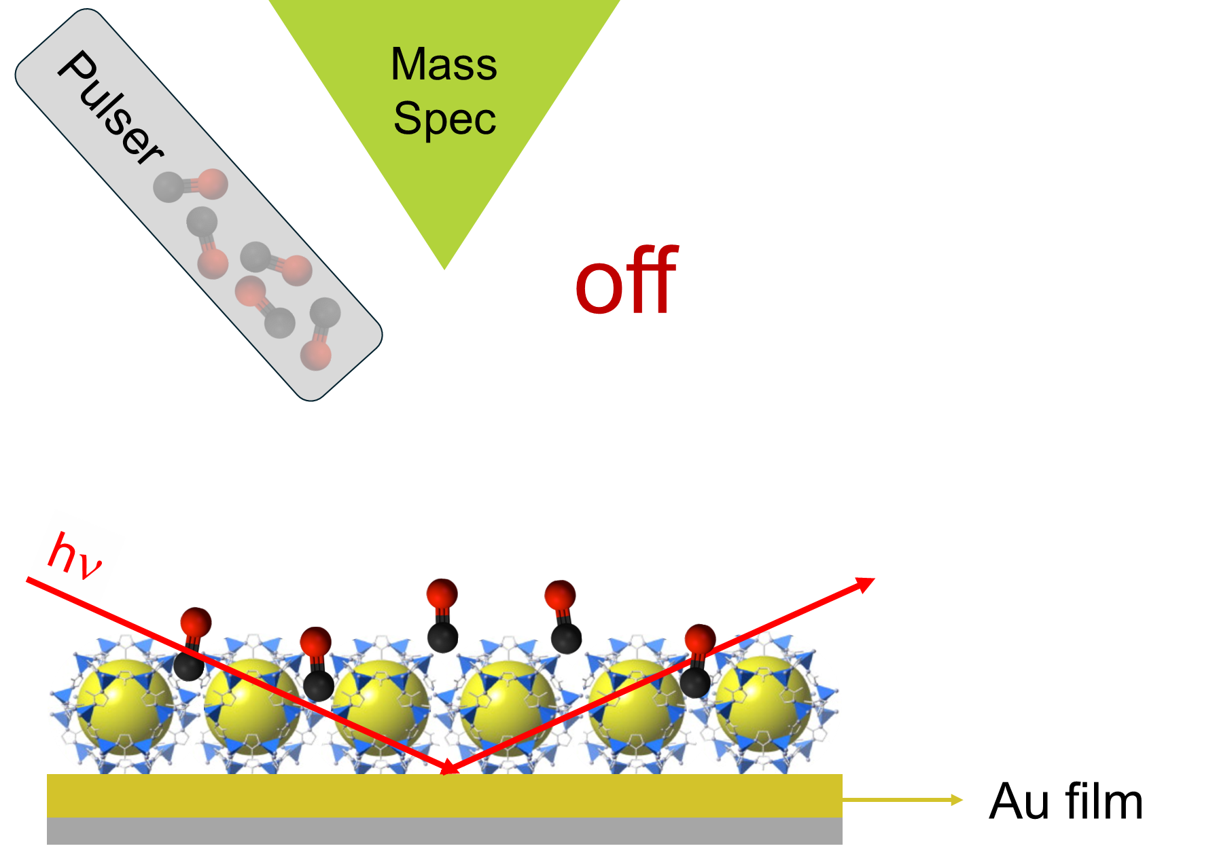

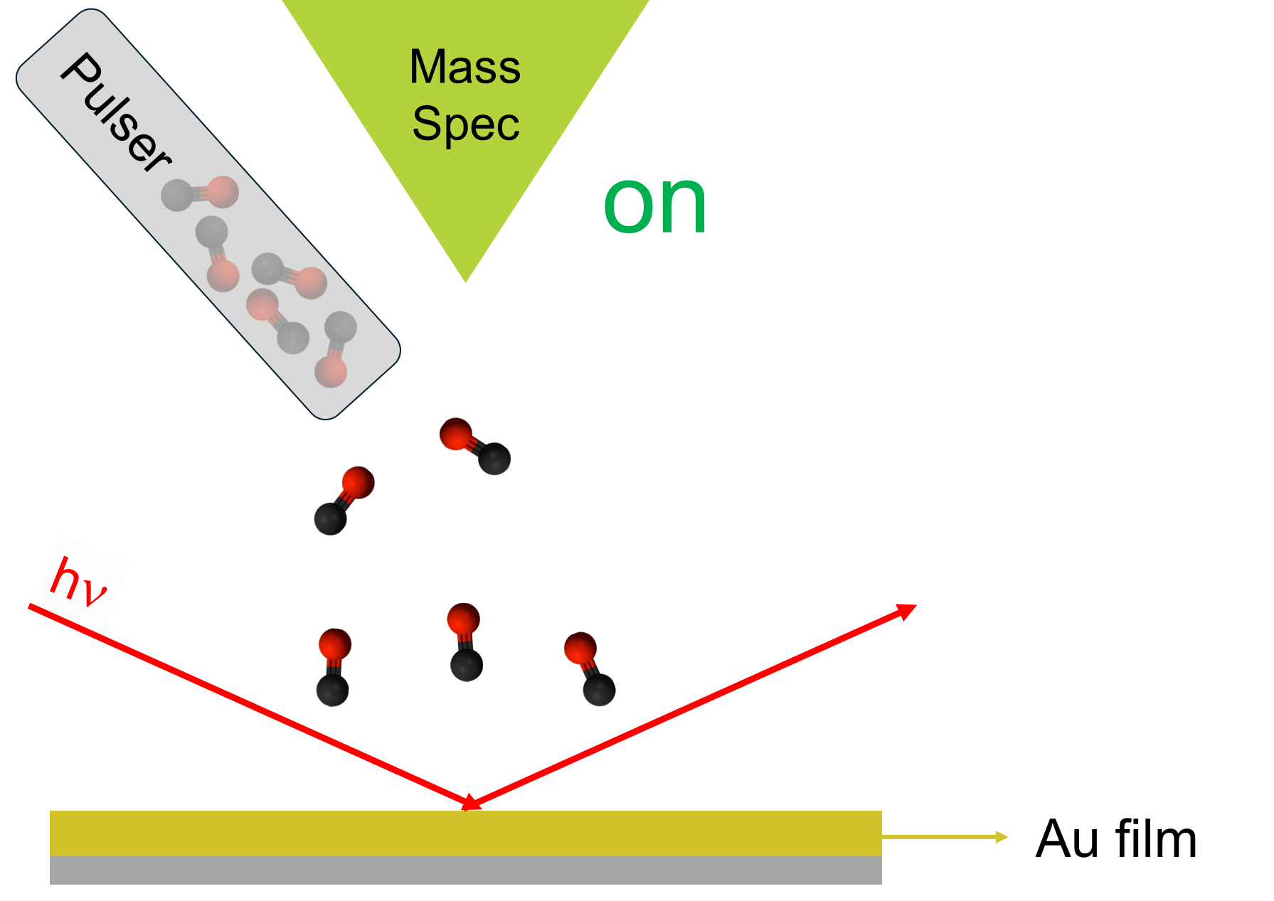


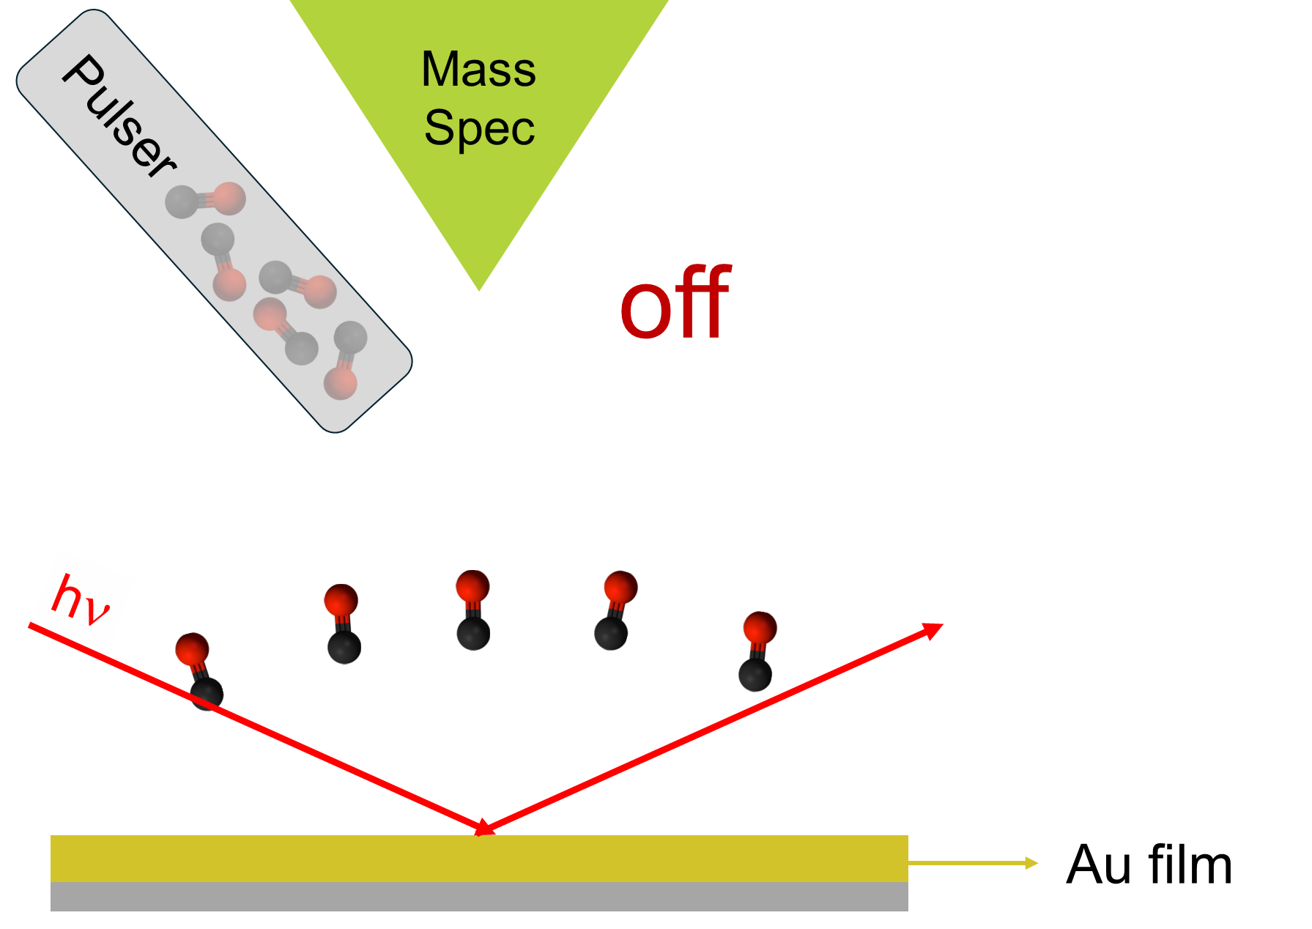
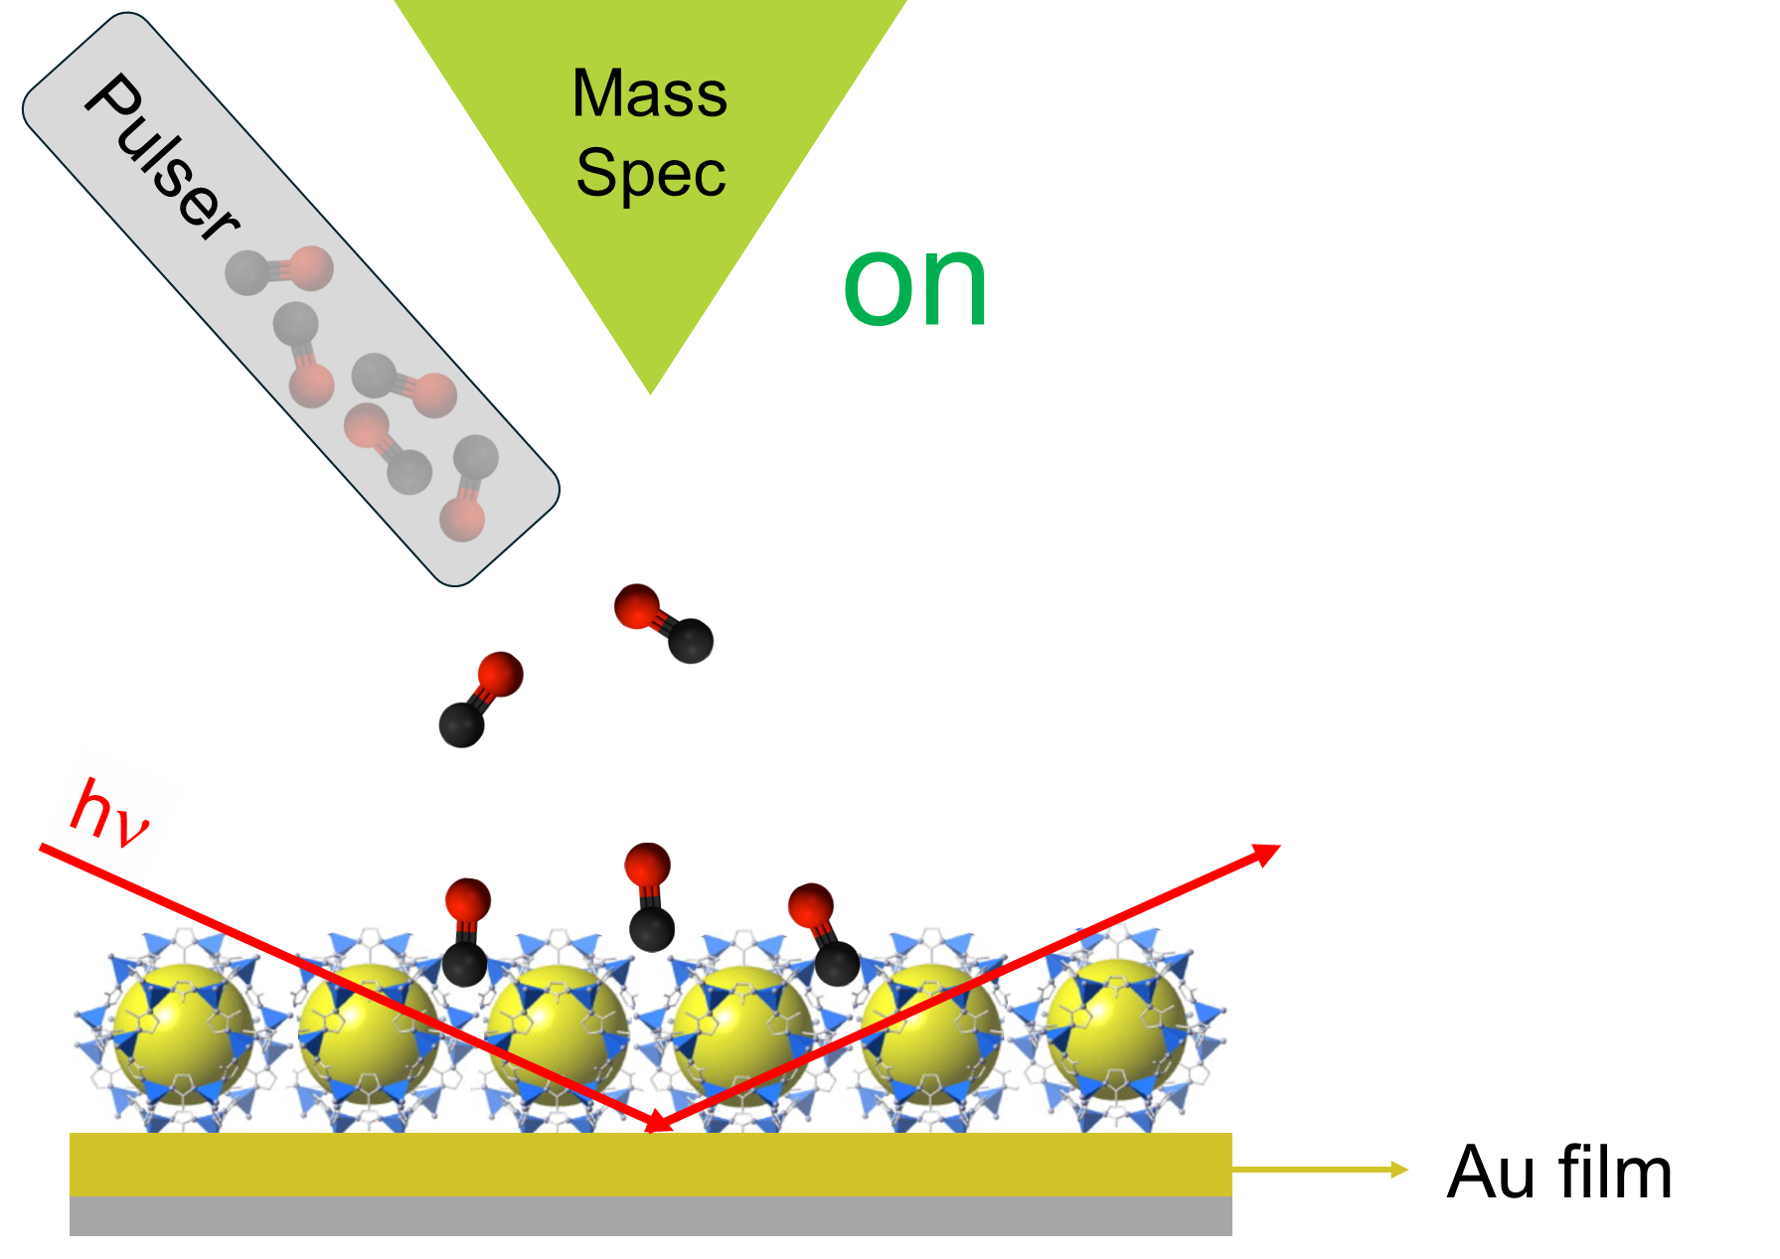


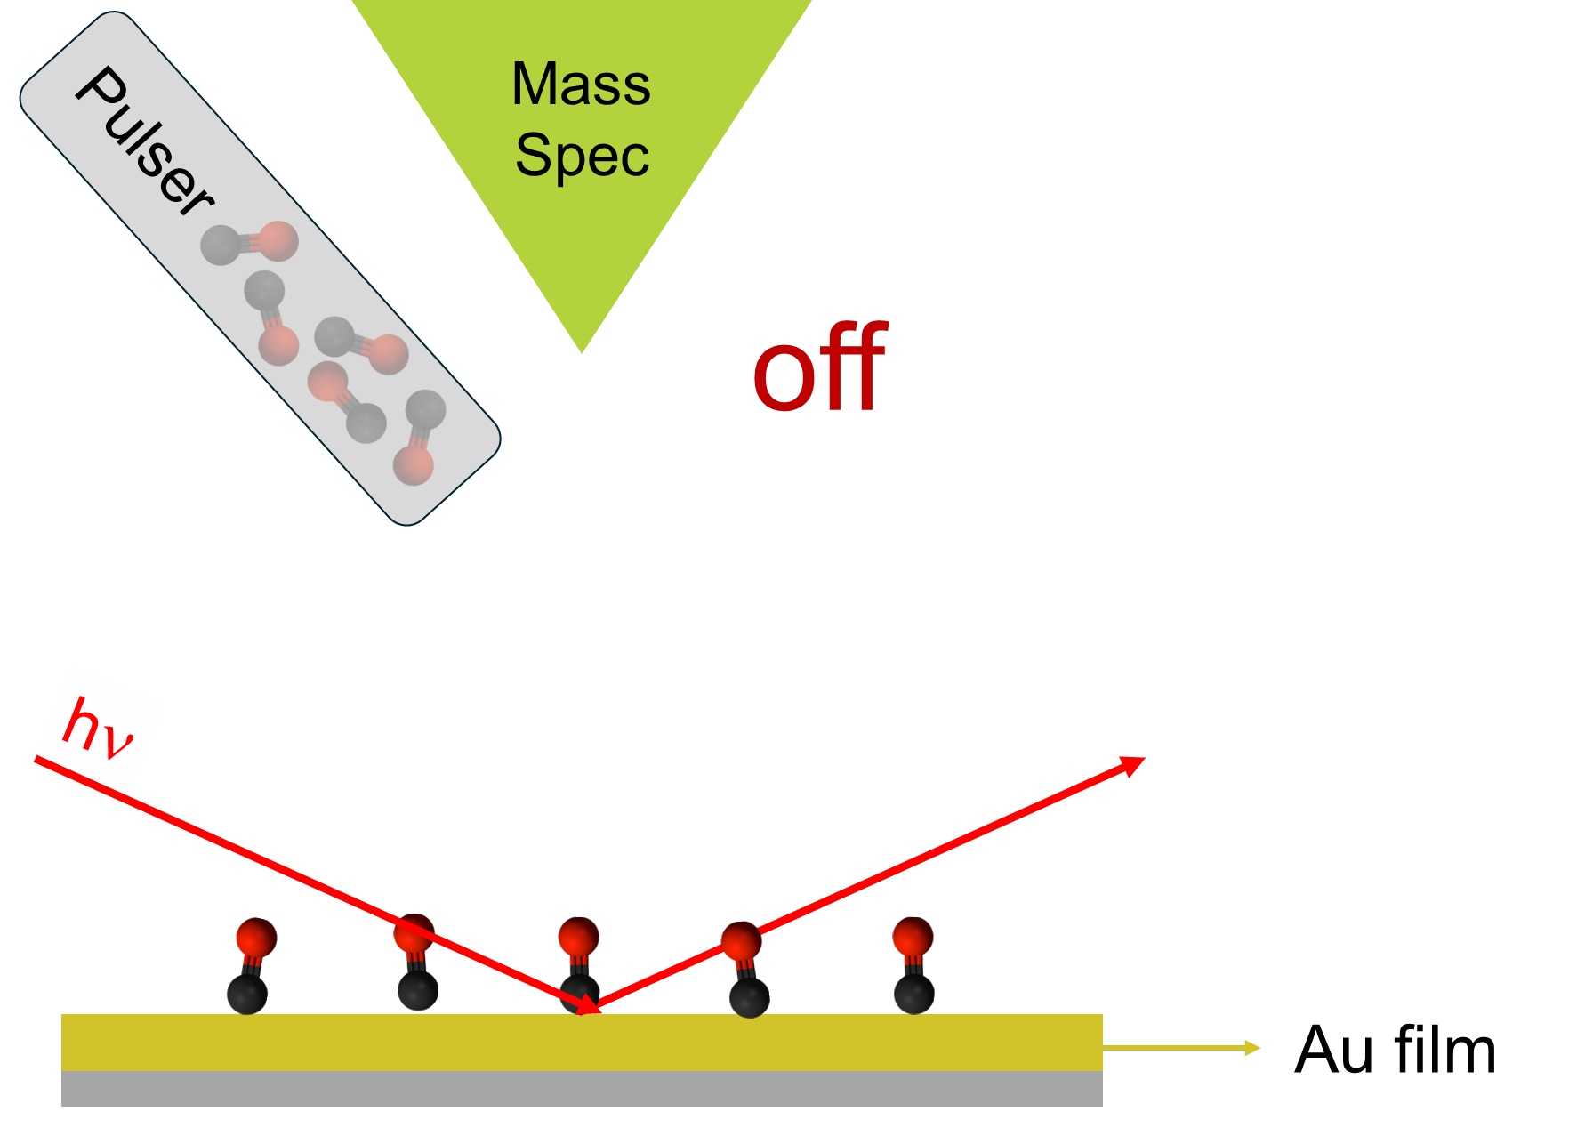
Pulsing valve system: pulses of CO on a ZIF-8 and Au films
2 s on
18 s off
83 ms time resolution in mass spectrometry
2 s on
18 s off
83 ms time resolution in mass spectrometry
120 K
300 pulses
120 K
300 pulses

Slide 5
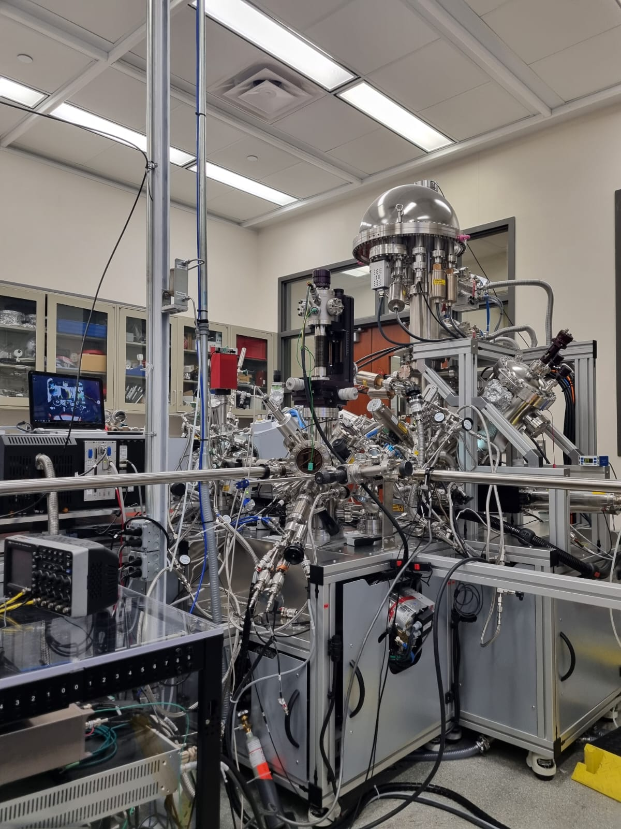
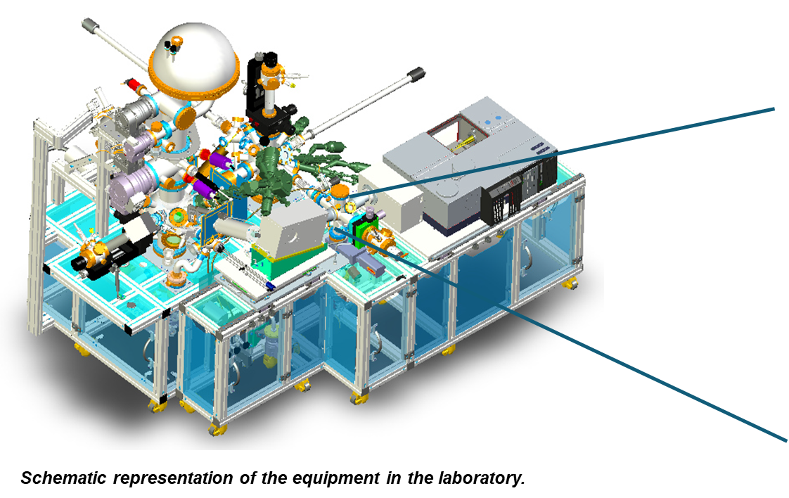
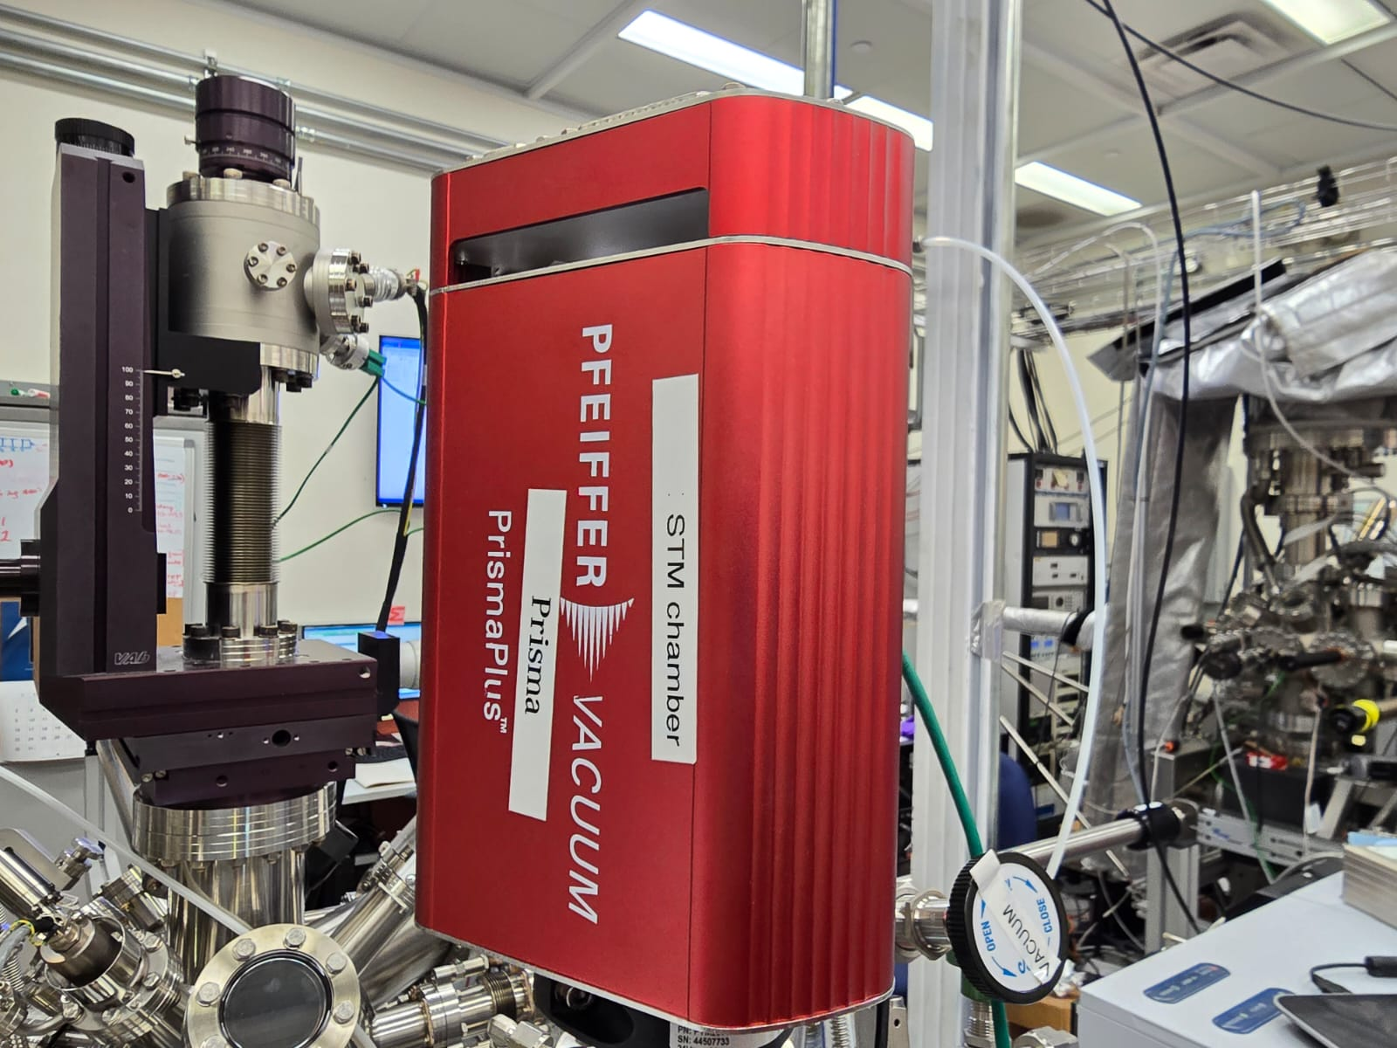
Techniques: IRRAS and MS
Mass Spectrometer.
A schematic sample in the IRRAS chamber.
IRRAS chamber at the Center for Functional Nanomaterials.

Slide 6
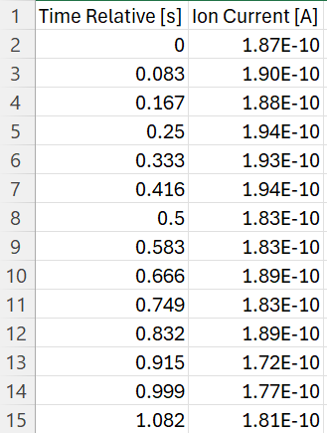
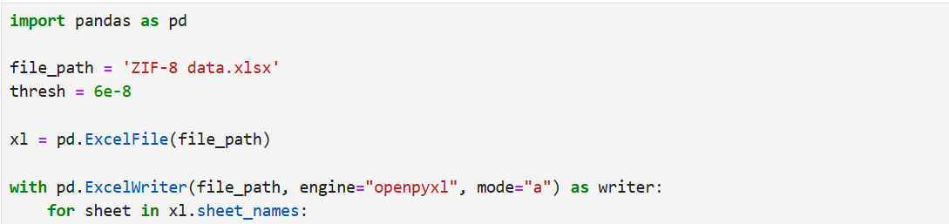
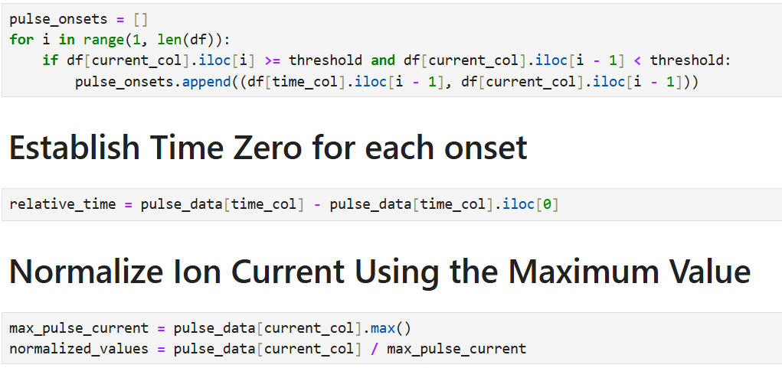
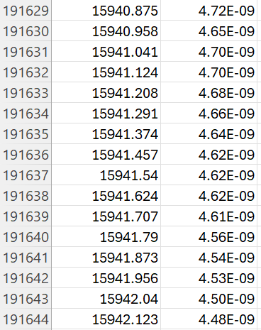
Use of Python to analyze data from MS

Slide 7
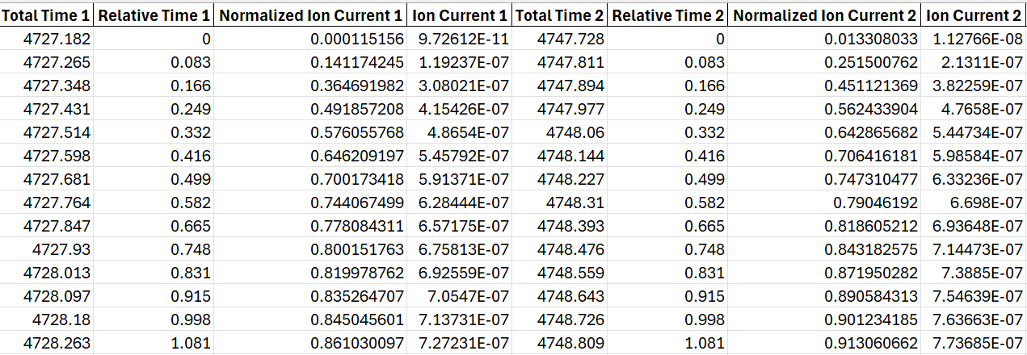
Use of Python to analyze data from MS

Slide 8
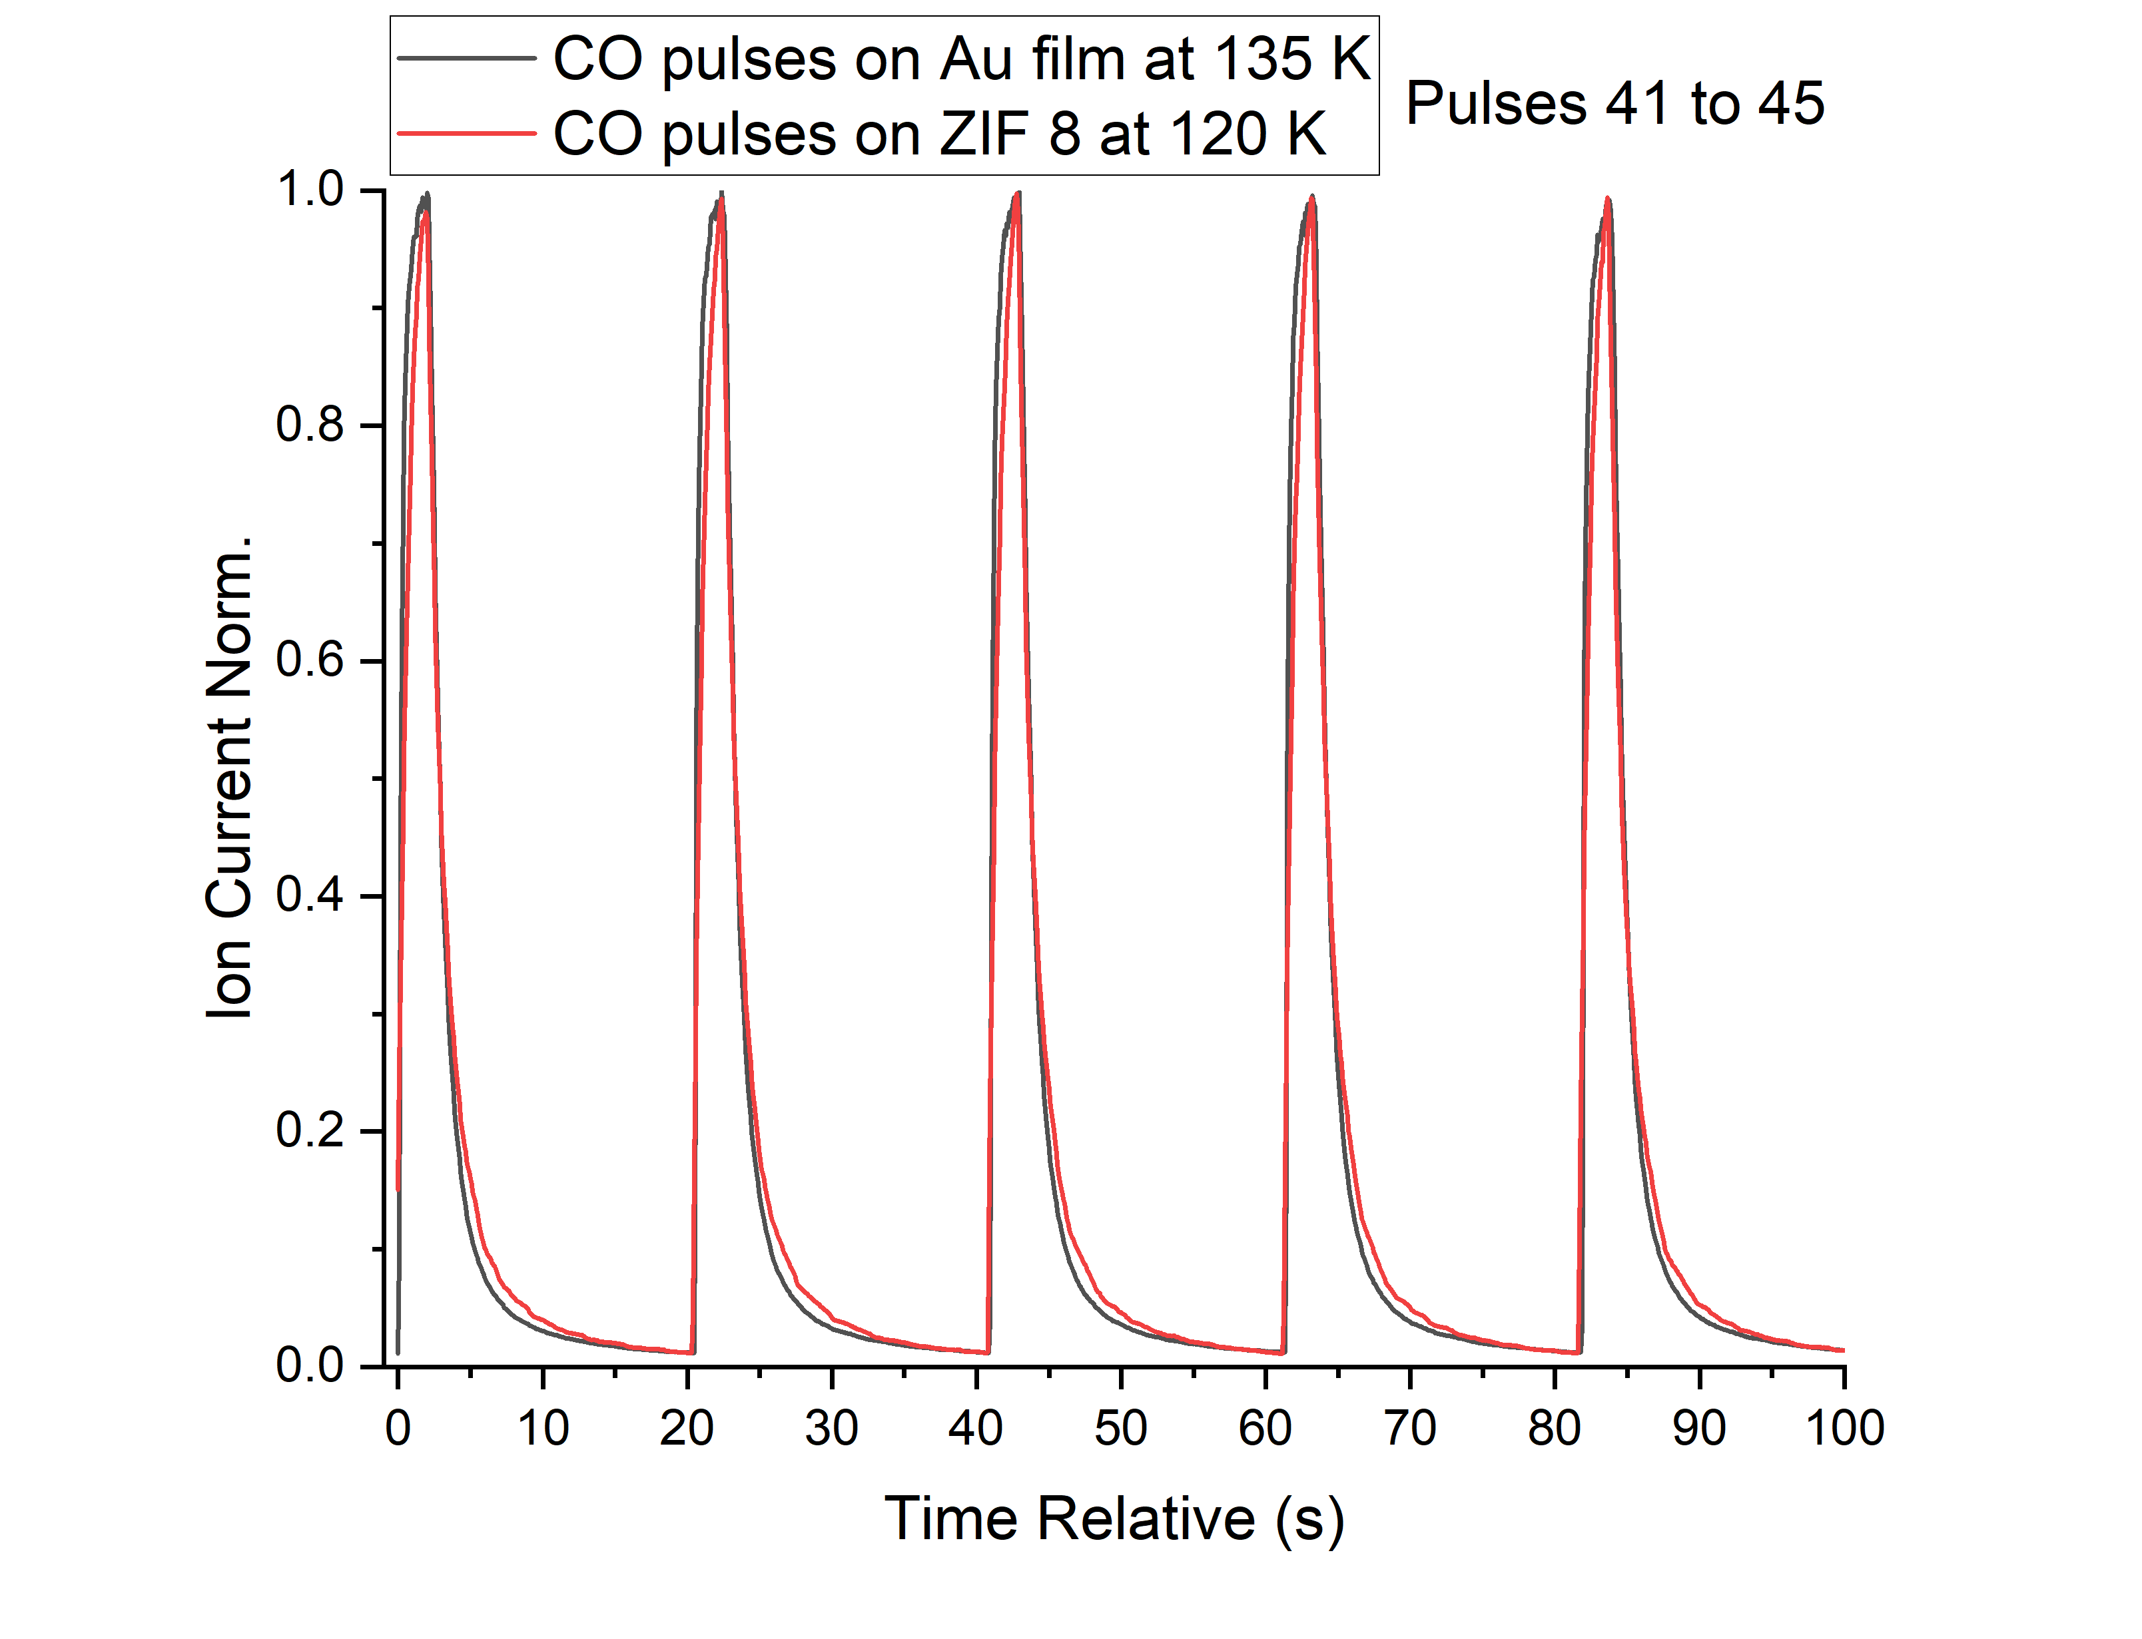
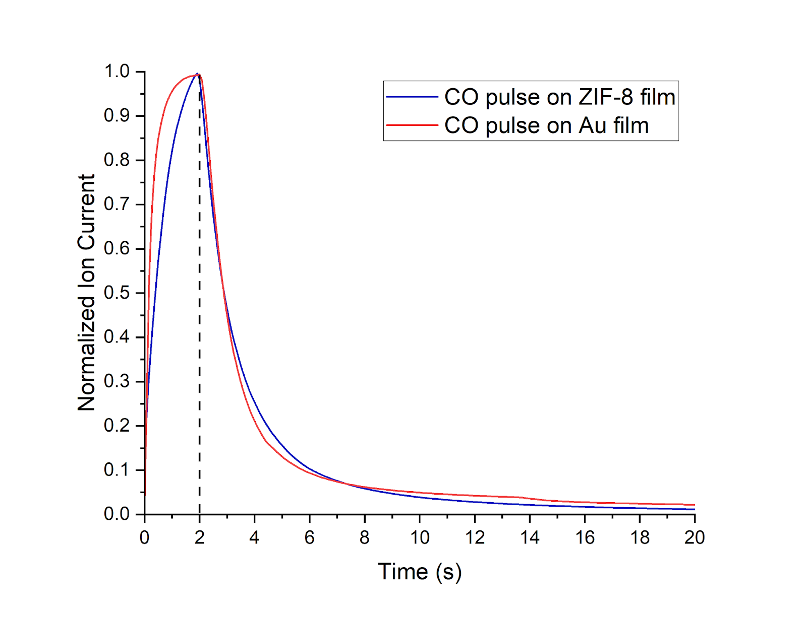
Use of Python to analyze data from MS

Slide 9
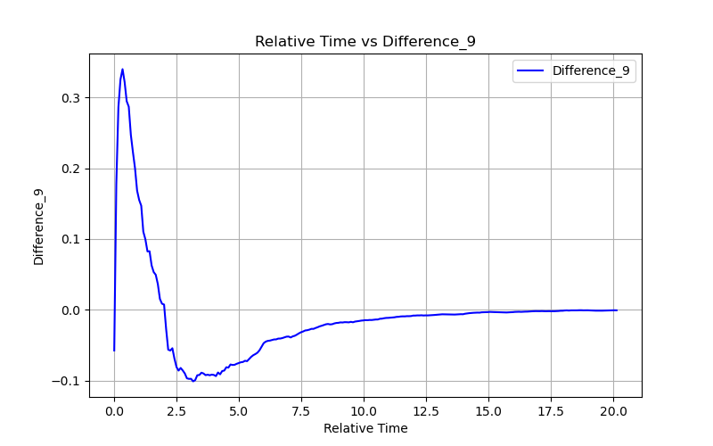
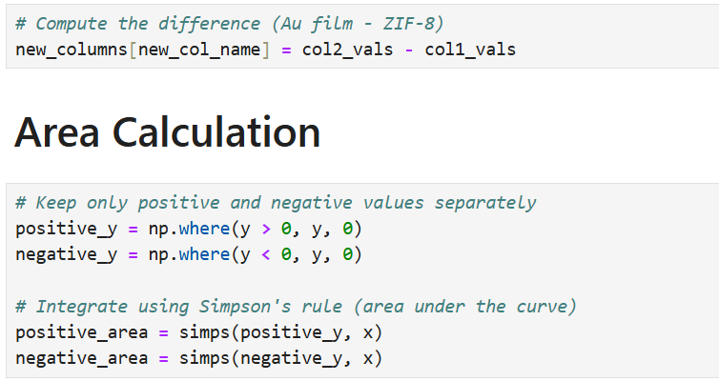
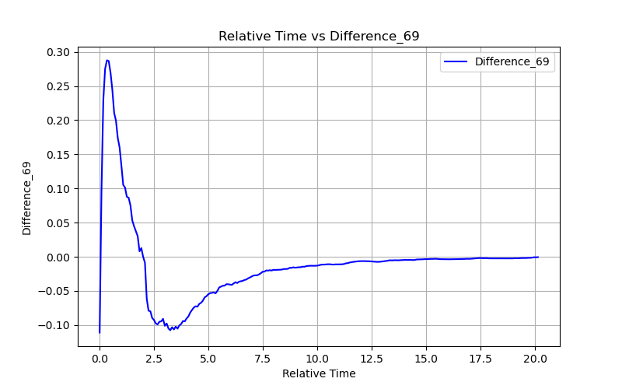
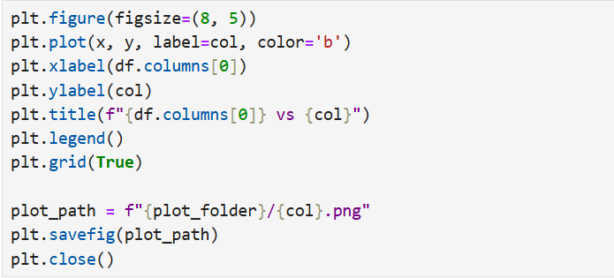
Use of Python to analyze data from MS
Average Positive Area | Average Negative Area
0.30 | -0.23

Slide 10
Conclusions
Mass spectrometry results indicate that the ZIF-8 film adsorbs CO molecules, temporarily retaining them on its surface before desorption, unlike the Au film.
Normalization of the data allows for a more accurate and visual comparison between the behaviors of ZIF-8 and Au films.
Future experiments will explore different pulse durations and a broader range of temperatures to better understand adsorption dynamics.
The use of Python significantly improves data processing speed and efficiency.
Additional automation features can be implemented in the Python script to further streamline the analysis workflow.

Slide 11
Thank You!

